Slide 1
Financial Accounting
Weygandt, Kimmel, Kieso
Eleventh Edition
Chapter 1
Accounting in Action
This slide deck contains animations. Please disable animations if they cause issues with your device.
©2020 John Wiley & Sons, Inc. All rights reserved.

Slide 2
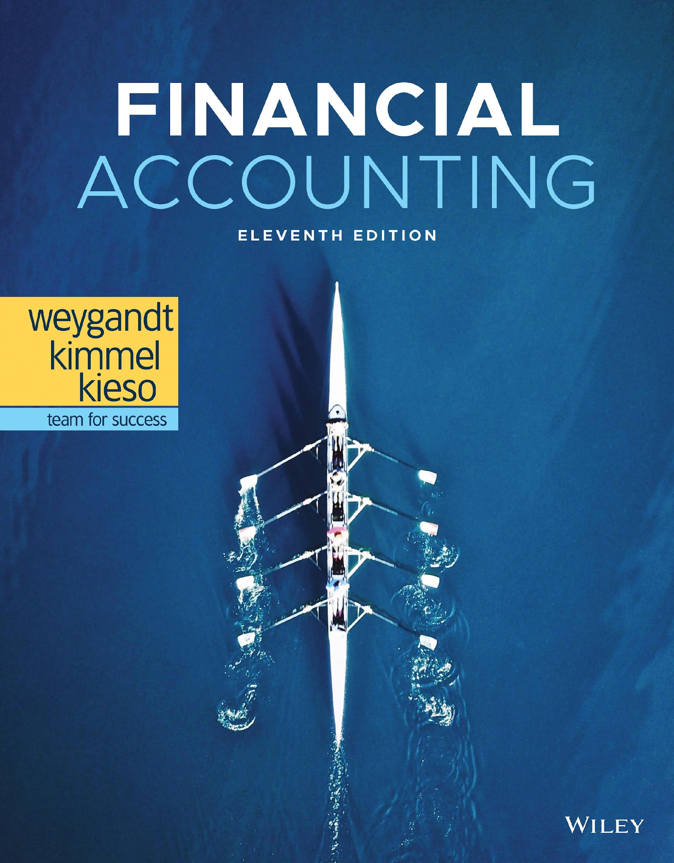
Financial Accounting

Slide 3
Accounting in Action
Learning Objectives
L O 1 Identify the activities and users associated with accounting.
L O 2 Explain the building blocks of accounting: ethics, principles, and assumptions.
L O 3 State the accounting equation and define its components.
L O 4 Analyze the effects of business transactions on the accounting equation.
L O 5 Describe the four financial statements and how they are prepared.

Slide 4
LEARNING OBJECTIVE 1 Identify the Activities and Users Associated with Accounting
Accounting consists of three basic activities—it
Identifies – (i) money measurement, (ii) at least two parties/accounts and (iii) change the Financial Position of the entity/organization.
records, and
communicates
the economic events / transactions of an organization to interested users.
L O 1

Slide 5
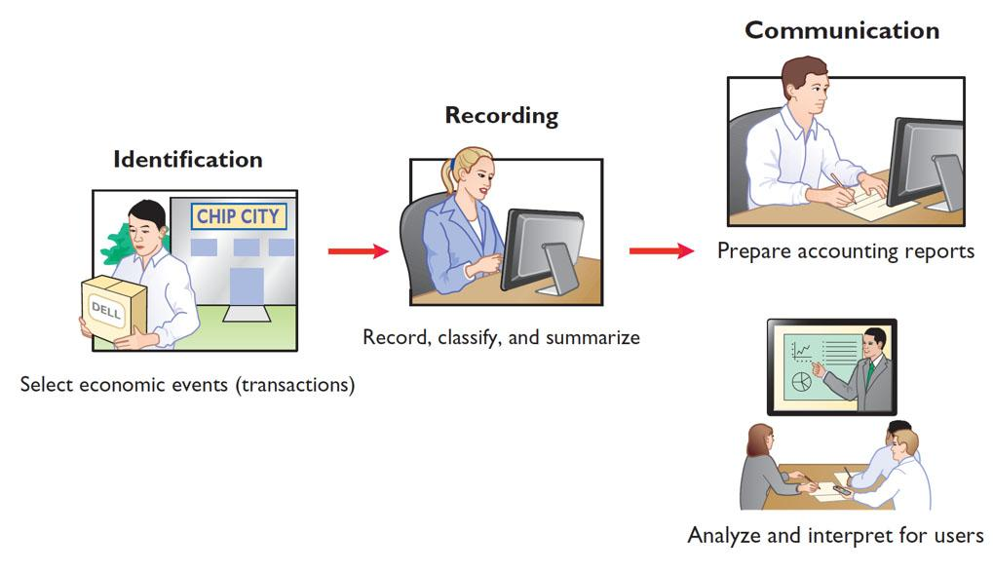
Three Activities
The accounting process includes the bookkeeping function.
L O 1

Slide 6
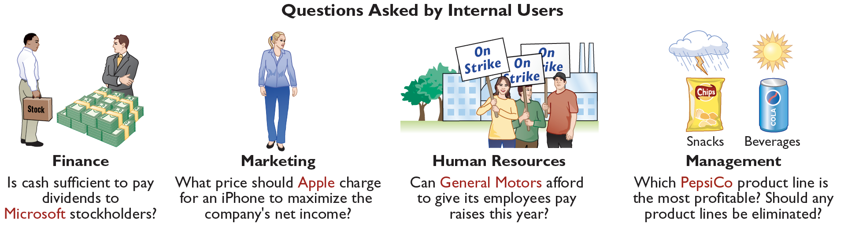
Who Uses Accounting Data Internal Users
L O 1

Slide 7

Accounting Across the Organization: Clif Bar & Company
Owning a Piece of the Bar
The original Clif Bar® energy bar was created in 1990 after six months of experimentation by Gary Erickson and his mother in her kitchen. Today, the company has approximately 1,000 employees and was named one of the leading Landor’s Breakaway Brands®. One of Clif Bar & Company’s proudest moments was the creation of an employee stock ownership plan (E S O P) in 2010. This plan gives its employees 20% ownership of the company. The E S O P also resulted in Clif Bar enacting an open-book management program, including the commitment to educate all employee-owners about its finances. Armed with basic accounting knowledge, employees are more aware of the financial impact of their actions, which leads to better decisions.
L O 1

Slide 8
Accounting Across the Organization: Clif Bar & Company (Question and Answer)
Owning a Piece of the Bar
What are the benefits to the company and to the employees of making the financial statements available to all employees?
Answer:
If employees can read and use financial reports, a company will benefit in the following ways. The marketing department will make better decisions about products to offer and prices to charge. The finance department will make better decisions about debt and equity financing and how much to distribute in dividends. The production department will make better decisions about when to buy new equipment and how much inventory to produce. The human resources department will be better able to determine whether employees can be given raises. Finally, all employees will be better informed about the basis on which they are evaluated, which will increase employee morale.
L O 1

Slide 9
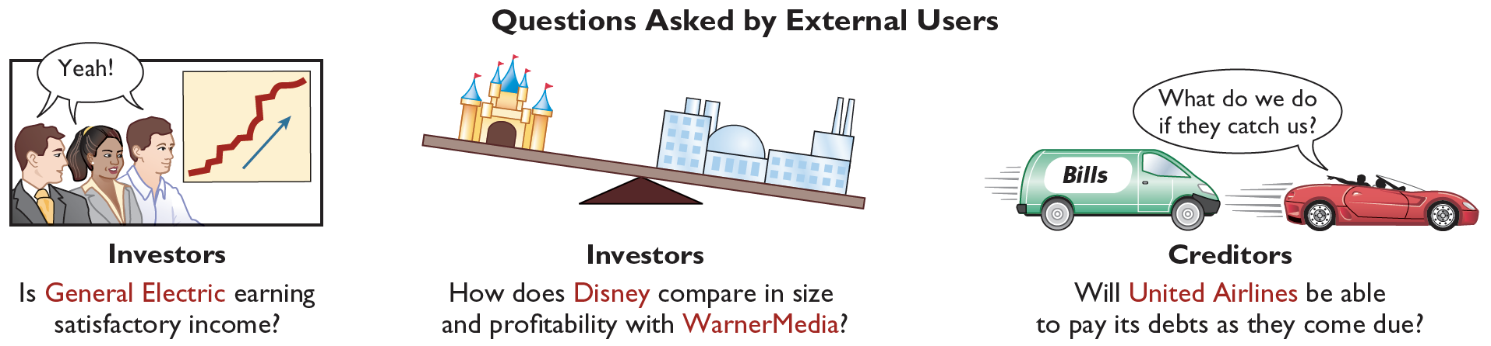
Who Uses Accounting Data External Users
L O 1

Slide 10
DO IT! 1: Basic Concepts
Indicate whether the following statements are true or false.
The three steps in the accounting process are identification, recording, and communication.
Bookkeeping encompasses all steps in the accounting process.
Accountants prepare, but do not interpret, financial reports.
The two most common types of external users are investors and company officers.
Managerial accounting activities focus on reports for internal users.
Solution:
True
False
False
False
True
L O 1

Slide 11
LEARNING OBJECTIVE 2 Explain the Building Blocks of Accounting: Ethics, Principles, and Assumptions
Ethics in Financial Reporting
Recent financial scandals include Enron, WorldCom, HealthSouth, A I G, and other companies.
Regulators and lawmakers were concerned that the economy would suffer if investors lost confidence in corporate accounting. In response, Congress passed Sarbanes-Oxley Act (S O X).
Effective financial reporting depends on sound ethical behavior.
L O 2

Slide 12
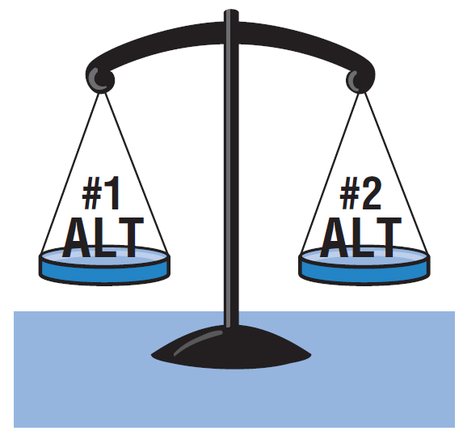
Ethics in Financial Reporting Steps
Recognize an ethical situation and the ethical issues involved.
Use your personal ethics to identify ethical situations and issues. Some businesses and professional organizations provide written codes of ethics for guidance in some business situations.
Identify and analyze the principal elements in the situation.
Identify the stakeholders—persons or groups who may be harmed or benefited. Ask the question: What are the responsibilities and obligations of the parties involved?
Identify the alternatives, and weigh the impact of each alternative on various stakeholders.
Select the most ethical alternative, considering all the consequences. Sometimes there will be one right answer. Other situations involve more than one right solution; these situations require an evaluation of each and a selection of the best alternative.
L O 2

Slide 13
Ethics in Financial Reporting Question
Ethics are the standards of conduct by which one’s actions are judged as:
right or wrong.
honest or dishonest.
fair or not fair.
all of these options.
L O 2

Slide 14
Ethics in Financial Reporting Answer
Ethics are the standards of conduct by which one’s actions are judged as:
right or wrong.
honest or dishonest.
fair or not fair.
Answer: all of these options.
L O 2

Slide 15

Ethics Insight: Dewey & LeBoeuf L L P
I Felt the Pressure—Would You?
“I felt the pressure.” That’s what some of the employees of the now-defunct law firm of Dewey & LeBoeuf LLP indicated when they helped to overstate revenue and use accounting tricks to hide losses and cover up cash shortages. These employees worked for the former finance director and former chief financial officer (CFO) of the firm. Here are some of their comments:
“I was instructed by the CFO to create invoices, knowing they would not be sent to clients. When I created these invoices, I knew that it was inappropriate.”
“I intentionally gave the auditors incorrect information in the course of the audit.
What happened here is that a small group of lower-level employees over a period of years carried out the instructions of their bosses. Their bosses, however, seemed to have no concern about unethical practices as evidenced by various e-mails with one another in which they referred to their financial manipulations as accounting tricks, cooking the books, and fake income.
Sources: Ashby Jones, “Guilty Pleas of Dewey Staff Detail the Alleged Fraud,” Wall Street Journal (March 28, 2014); and Sara Randazzo, “Dewey CFO Escapes Jail Time in Fraud Case Sentencing,” Wall Street Journal (October 10, 2017).
L O 2

Slide 16
Ethics Insight: Dewey & LeBoeuf L L P (Question and Answer)
I Felt the Pressure—Would You?
Why did these employees lie, and what do you believe should be their penalty for these lies?
Answer:
They felt pressured by their supervisors to make the company's financial statements look better than warranted. They should be prosecuted for fraudulent activities under the Sarbanes-Oxley Act, as they knowingly misstated financial statement data.
L O 2

Slide 17



Generally Accepted Accounting Principles Need for Financial Information
Various users need financial information
Financial Statements
Balance Sheet
Income Statement
Statement of Stockholders’ Equity
Statement of Cash Flows
Note Disclosure
The accounting profession has developed standards that are generally accepted and universally practiced.
Generally Accepted Accounting Principles (G A A P)
L O 2

Slide 18
Generally Accepted Accounting Principles Standard-setting Bodies
Generally Accepted Accounting Principles (G A A P) – Standards that are generally accepted and universally practiced. These standards indicate how to report economic events.
Standard-setting bodies:
Financial Accounting Standards Board (F A S B)
Securities and Exchange Commission (S E C)
International Accounting Standards Board (I A S B)
International Note
Over 115 countries use international standards (called I F R S). For example, all companies in the European Union follow I F R S. The differences between U.S. and international standards are not generally significant.
L O 2

Slide 19
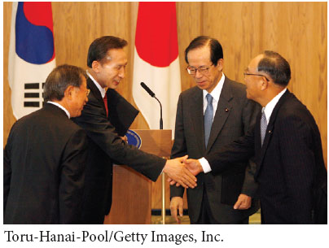
International Insight
The Korean Discount
If you think that accounting standards don’t matter, consider recent events in South Korea. For many years, international investors complained that the financial reports of South Korean companies were inadequate and inaccurate. Accounting practices there often resulted in huge differences between stated revenues and actual revenues. Because investors did not have faith in the accuracy of the numbers, they were unwilling to pay as much for the shares of these companies relative to shares of comparable companies in different countries. This difference in share price was often referred to as the “Korean discount.”
In response, Korean regulators decided that companies would have to comply with international accounting standards. This change was motivated by a desire to “make the country’s businesses more transparent” in order to build investor confidence and spur economic growth. Many other Asian countries, including China, India, and Japan, have also decided either to adopt international standards or to create standards that are based on the international standards.
Source: Evan Ramstad, “End to ‘Korea Discount’?” Wall Street Journal (March 16, 2007).
L O 2

Slide 20
GAAP
Principles – 4
-cost principles
-Full disclosure principle
2. Assumptions - 4
3. Constraints – 2-Materiality
L O 2

Slide 21
Measurement Principles
Historical Cost Principle (or cost principle) dictates that companies record assets at their cost.
Fair Value Principle states that assets and liabilities should be reported at fair value (the price received to sell an asset or settle a liability).
In determining which measurement principle to use, companies weigh the factual nature of cost figures versus the relevance of fair value. In general, most companies choose to use cost. Only in situations where assets are actively traded, such as investment securities, do companies apply the fair value principle extensively.
L O 2

Slide 22
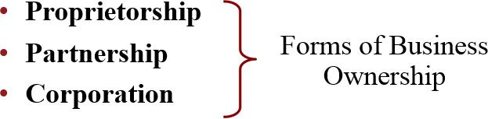
Assumptions Monetary Unit and Economic Entity
Monetary Unit Assumption requires that companies include in the accounting records only transaction data that can be expressed in money terms.
Economic Entity Assumption requires that activities of the entity be kept separate and distinct from the activities of its owner and all other economic entities.
L O 2

Slide 23
Forms of Business Ownership
Proprietorship
Owned by one person
Owner is often manager/operator
Owner receives any profits, suffers any losses, and is personally liable for all debts
Partnership
Owned by two or more persons
Often retail and service-type businesses
Generally unlimited personal liability
Partnership agreement
Corporation
Ownership divided into shares of stock
Separate legal entity organized under state corporation law
Limited liability
L O 2

Slide 24
Assumptions First Question
Combining the activities of Kellogg and General Mills would violate the
cost principle.
economic entity assumption.
monetary unit assumption.
ethics principle.
L O 2

Slide 25
Assumptions First Answer
Combining the activities of Kellogg and General Mills would violate the
cost principle.
Answer: economic entity assumption.
monetary unit assumption.
ethics principle.
L O 2

Slide 26
Assumptions Second Question
A business organized as a separate legal entity under state law having ownership divided into shares of stock is a
proprietorship.
partnership.
corporation.
sole proprietorship.
L O 2

Slide 27
Assumptions Second Answer
A business organized as a separate legal entity under state law having ownership divided into shares of stock is a
proprietorship.
partnership.
Answer: corporation.
sole proprietorship.
L O 2

Slide 28

Accounting Across the Organization
Spinning the Career Wheel
How will the study of accounting help you? A working knowledge of accounting is desirable for virtually every field of business. Some examples of how accounting is used in business careers include:
General management: Managers at Ford Motors, Massachusetts General Hospital, California State University— Fullerton, a McDonald’s franchise, and a Trek bike shop all need to understand accounting data in order to make wise business decisions.
Marketing: Marketing specialists at Procter & Gamble must be sensitive to costs and benefits, which accounting helps them quantify and understand. Making a sale is meaningless unless it is a profitable sale.
Finance: Do you want to be a banker for Citicorp, an investment analyst for Goldman Sachs, or a stock broker for Merrill Lynch? These fields rely heavily on accounting knowledge to analyze financial statements. In fact, it is difficult to get a good job in a finance function without two or three courses in accounting.
Real estate: Are you interested in being a real estate broker for Prudential Real Estate? Because a third party—the bank—is almost always involved in financing a real estate transaction, brokers must understand the numbers involved: Can the buyer afford to make the payments to the bank? Does the cash flow from an industrial property justify the purchase price? What are the tax benefits of the purchase?
L O 2

Slide 29
Accounting Across the Organization (Question and Answer)
Spinning the Career Wheel
How might accounting help you?
Answer:
You will need to understand financial reports in any enterprise with which you are associated. Whether you become a manager, a doctor, a lawyer, a social worker, a teacher, an engineer, an architect, or an entrepreneur, a working knowledge of accounting is relevant.
L O 2

Slide 30
DO IT! 2: Building Blocks of Accounting Questions 1-3
Indicate whether each of the following statements presented below is true or false.
Congress passed the Sarbanes-Oxley Act to reduce unethical behavior and decrease the likelihood of future corporate scandals.
True
The primary accounting standard-setting body in the United States is the Financial Accounting Standards Board (F A S B).
True
The historical cost principle dictates that companies record assets at their cost. In later periods, however, the fair value of the asset must be used if its fair value is higher than its cost.
False
L O 2

Slide 31
DO IT! 2: Building Blocks of Accounting Questions 4-5
Indicate whether each of the following statements presented below is true or false.
Relevance means that financial information matches what really happened; the information is factual.
False
A business owner’s personal expenses must be separated from expenses of the business to comply with accounting’s economic entity assumption.
True
L O 2

Slide 32
LEARNING OBJECTIVE 3 State the Accounting Equation, and Define its Components
Luca Pacioli - 1494
Assets = obligation
Assets = Liabilities + Stockholders’ Equity
Basic Accounting Equation
Provides the underlying framework for recording and summarizing economic events.
Assets must equal the sum of liabilities and stockholders’ equity.
If a business is liquidated, claims of creditors (liabilities) must be paid before ownership claims (stockholders’ equity).
L O 3

Slide 33
Basic Accounting Equation Assets
Assets = Liabilities + Stockholders’ Equity
Assets
Resources a business owns.
Provide future services or benefits.
Cash, Supplies, Equipment, etc.
L O 3

Slide 34
Basic Accounting Equation Liabilities
Assets = Liabilities + Stockholders’ Equity
Liabilities
Claims against assets (debts and obligations).
Creditors (party to whom money is owed).
Accounts payable, notes payable, salaries and wages payable, sales and real estate taxes payable, etc.
L O 3

Slide 35
Basic Accounting Equation Stockholders’ Equity
Assets = Liabilities + Stockholders’ Equity
Stockholders’ Equity
Ownership claim on total assets.
Referred to as residual equity.
Common stock and retained earnings.
L O 3

Slide 36
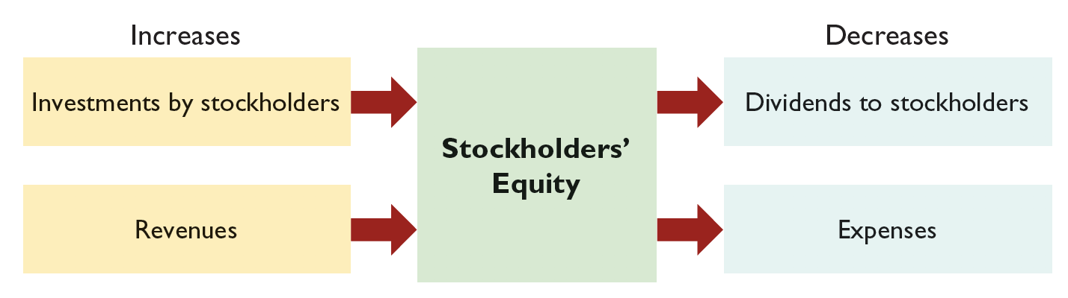
Stockholders’ Equity Investments by Stockholders
Investments by stockholders represents the total amount paid in by stockholders for the shares they purchase.
L O 3

Slide 37
Stockholders’ Equity Revenues
Revenues result from business activities entered into for the purpose of earning income.
Common sources of revenue are: sales, fees, services, commissions, interest, dividends, royalties, and rent.
L O 3

Slide 38
Stockholders’ Equity Dividends
Dividends are the distribution of cash or other assets to stockholders.
Dividends reduce retained earnings. However, dividends are not an expense.
L O 3

Slide 39
Stockholders’ Equity Expenses
Expenses are the cost of assets consumed or services used in the process of earning revenue.
Common expenses are: salaries expense, rent expense, utilities expense, tax expense, etc.
L O 3

Slide 40
DO IT! 3: Stockholders’ Equity Effects
Classify the following items as issuance of stock, dividends, revenues, or expenses. Then indicate whether each item increases or decreases stockholders’ equity.
Classification | Effect on Equity
1. Expense | Decrease
2. Revenue | Increase
3. Dividends | Decrease
4. Expense | Decrease
Rent Expense
Service Revenue
Dividends
Salaries and Wages Expense
L O 3

Slide 41
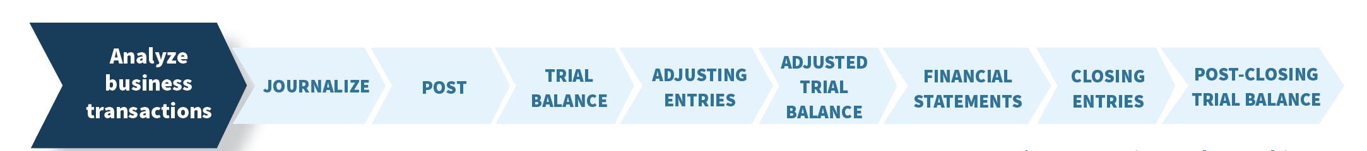
LEARNING OBJECTIVE 4 Analyze the Effects of Business Transactions on the Accounting Equation
Transactions are a business’s economic events recorded by accountants.
May be external or internal.
Not all activities represent transactions. Money, dual effect, changed the financial position of the business.
Have a dual effect on the accounting equation.
Assets = Liabilities + Stockholders’ Equity
500000 = 500000
300000 = 300000
L O 4

Slide 42
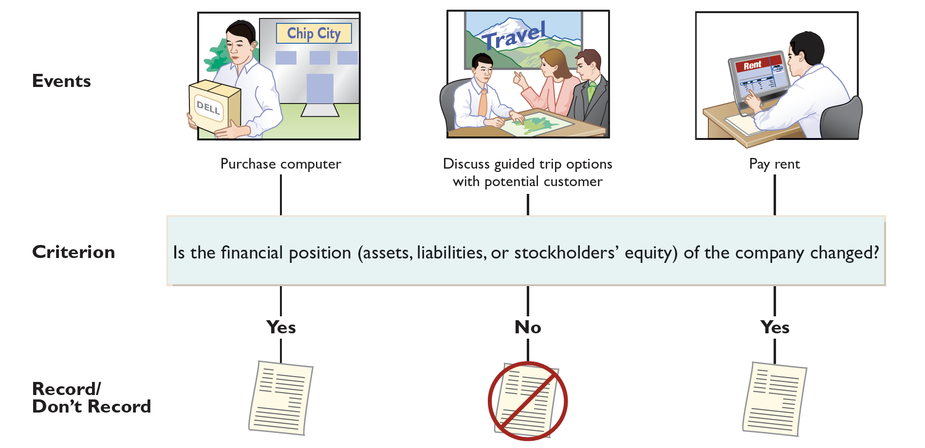
Transaction Analysis Transaction or Not?
L O 4

Slide 43
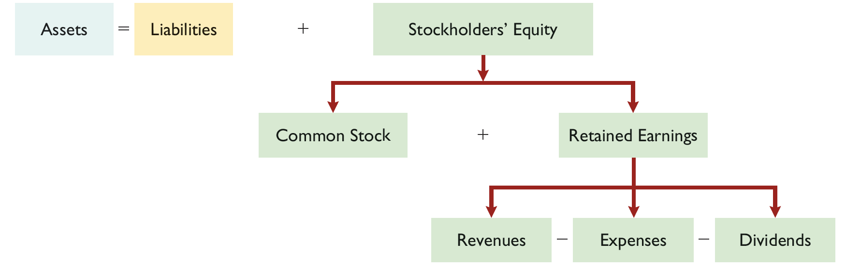
Transaction Analysis Accounting Equation
6000 - 4000=2000- 500=1500
L O 4
Notes:
■ Dividends decrease retained earnings, because they are distributions to stockholders of assets (usually cash) generated by net income. A successful business may pay dividends to shareholders as a return on their investments. Remember: dividends are not expenses.
Dividends never affect net income. Instead of being subtracted from revenues to compute net income, dividends are recorded as direct reductions of retained earnings.

Slide 44
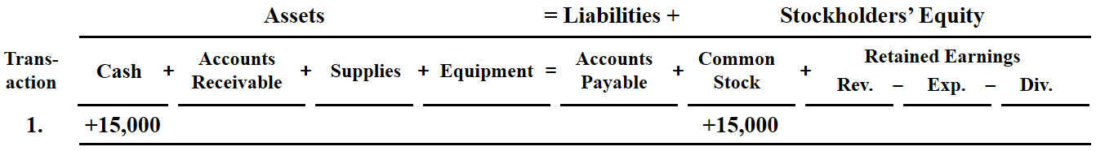
Transaction Analysis Investment of Cash by Stockholders
Transaction 1. Investment of Cash by Stockholders
Ray and Barbara Neal decide to start a smartphone app development company that they incorporate as Softbyte Inc. On September 1, 2020, they invest $15,000 cash in the business in exchange for $15,000 of common stock. The common stock indicates the ownership interest that the Neals have in Softbyte Inc. This transaction results in an equal increase in both assets and stockholders’ equity.
L O 4

Slide 45
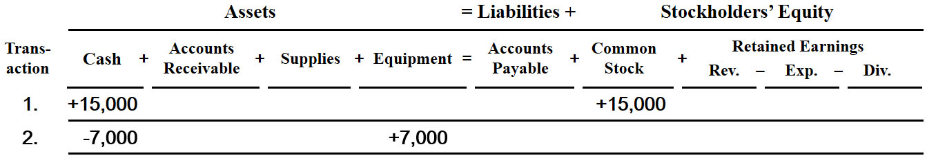
Transaction Analysis Purchase of Equipment for Cash
Transaction 2. Purchase of Equipment for Cash
Softbyte Inc. purchases computer equipment for $7,000 cash.
L O 4

Slide 46
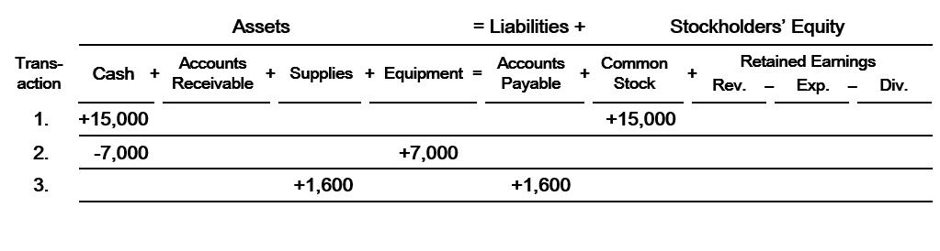
Transaction Analysis Purchase of Supplies on Credit
Transaction 3. Purchase of Supplies on account
Softbyte Inc. purchases for $1,600, headsets and other accessories expected to last several months. The supplier allows Softbyte to pay this bill in October.
L O 4

Slide 47
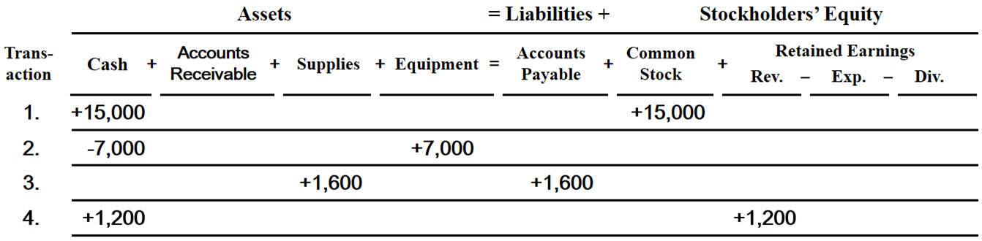
Transaction Analysis Services Performed for Cash
Transaction 4. Services Performed for Cash
Softbyte Inc. receives $1,200 cash from customers for app development services it has performed.
L O 4

Slide 48
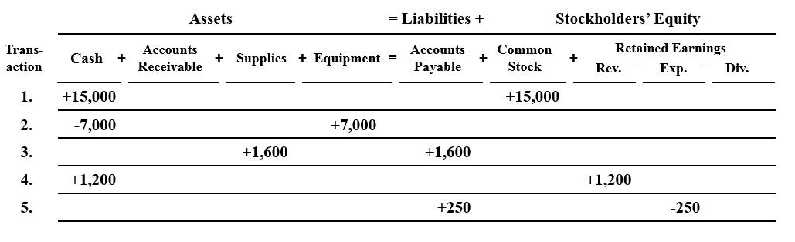
Transaction Analysis Purchase of Advertising on Credit
Transaction 5. Purchase of Advertising on Credit
Softbyte Inc. receives a bill for $250 from the Daily News for advertising on its online website but postpones payment until a later date.
L O 4

Slide 49
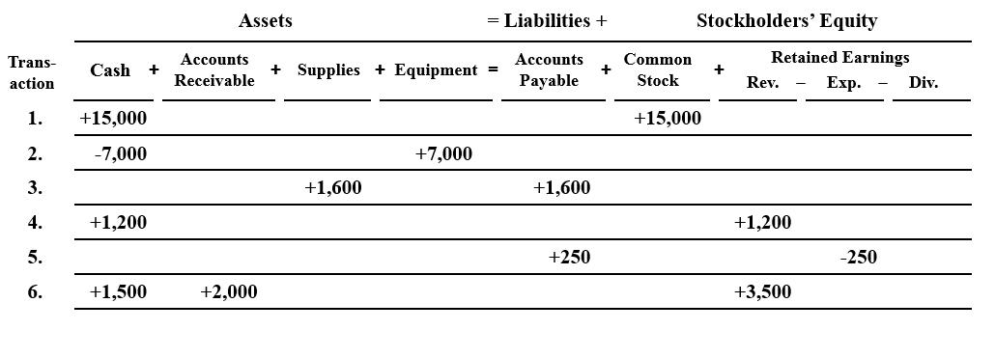
Transaction Analysis Services Performed for Cash and Credit
Transaction 6. Services Performed for Cash and Credit
Softbyte performs $3,500 of services. The company receives cash of $1,500 from customers, and it bills the balance of $2,000 on account.
L O 4

Slide 50
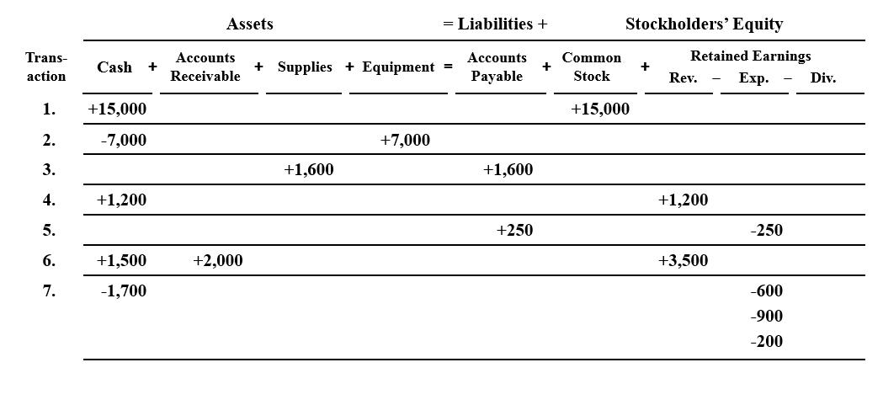
Transaction Analysis Payment of Expenses
Transaction 7. Payment of Expenses
Softbyte Inc. pays the following expenses in cash for September: office rent $600, salaries and wages of employees $900, and utilities $200.
L O 4

Slide 51
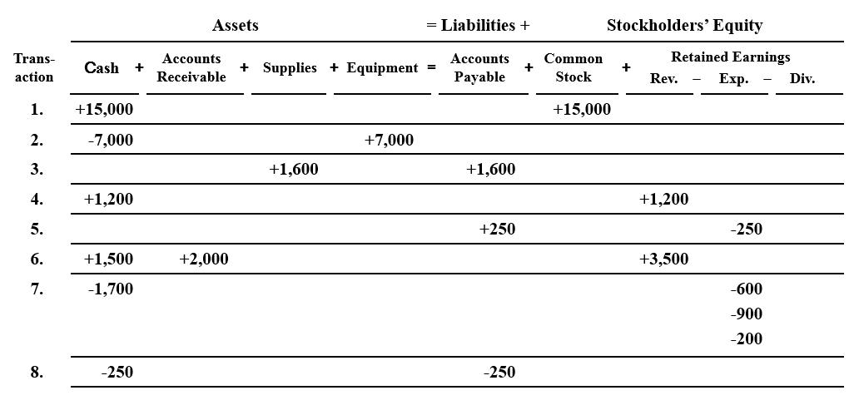
Transaction Analysis Payment of Accounts Payable
Transaction 8. Payment of Accounts Payable
Softbyte Inc. pays its $250 Daily News bill in cash. The company previously (in Transaction 5) recorded the bill as an increase in Accounts Payable and a decrease in stockholders’ equity.
L O 4

Slide 52
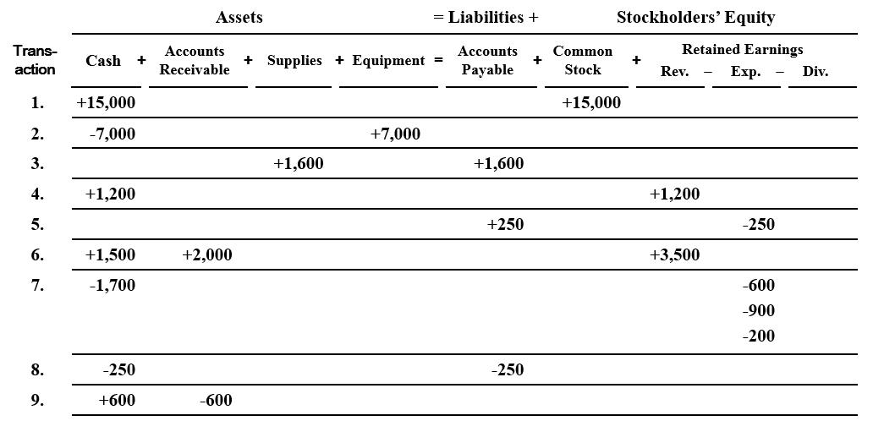
Transaction Analysis Receipt of Cash on Account
Transaction 9. Receipt of Cash On Account
Softbyte Inc. receives $600 in cash from customers who had been billed for services (in Transaction 6).
L O 4

Slide 53
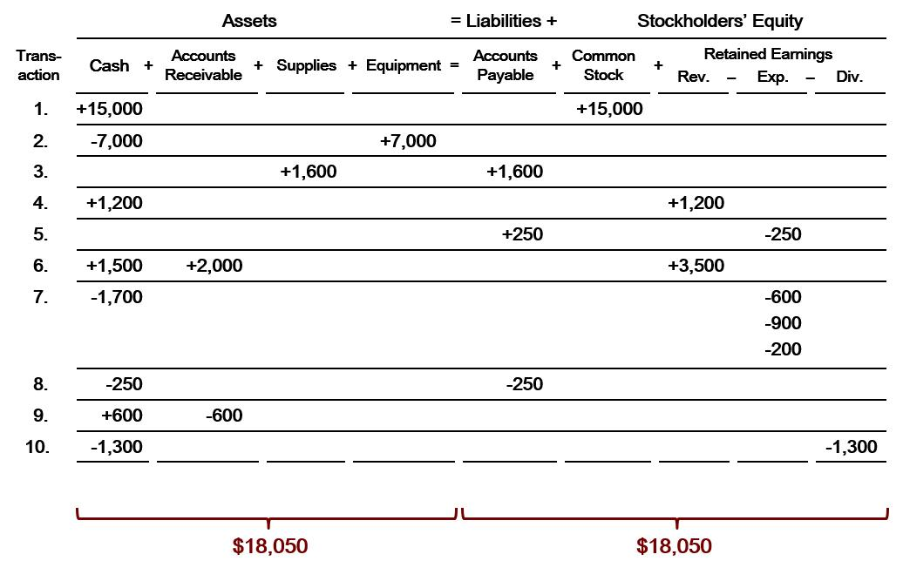
Transaction Analysis Dividends
Transaction 10. Dividends
The corporation pays a dividend of $1,300 in cash to Ray and Barbara Neal, the stockholders of Softbyte Inc.
L O 4

Slide 54
Summary of Transactions
Each transaction must be analyzed in terms of its effect on:
The three components of the basic accounting equation.
Specific types (kinds) of items within each component.
The two sides of the equation must always be equal.
The Common Stock and Retained Earnings columns indicate the causes of each change in the stockholders’ claim on assets.
L O 4

Slide 55
DO IT! 4: Tabular Analysis List of Transactions
Transactions made by Virmari & Co., a public accounting firm, for the month of August are shown below. Prepare a tabular analysis which shows the effects of these transactions on the expanded accounting equation, similar to that shown in Illustration 1-9.
Virmari sold shares of common stock for $25,000 cash.
The company purchased $7,000 of office equipment on credit.
The company received $8,000 cash in exchange for services performed.
The company paid $850 for this month’s rent.
The company paid a dividend of $1,000 in cash to stockholders.
L O 4

Slide 56
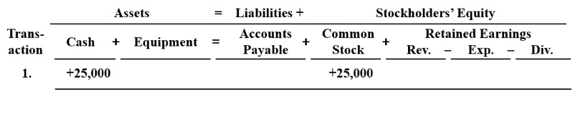
DO IT! 4: Tabular Analysis Investment of cash by stockholders
Virmari sold shares of common stock for $25,000 cash.
L O 4

Slide 57
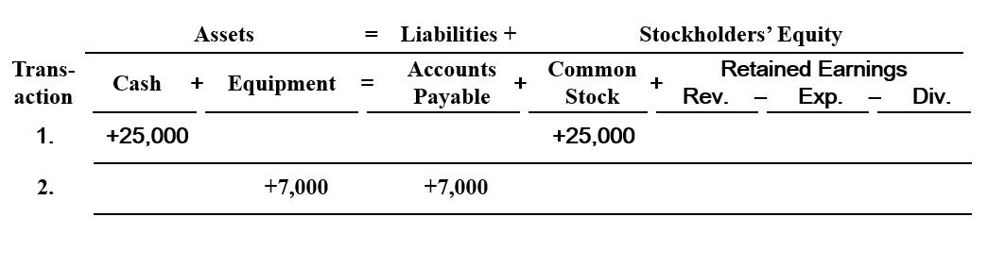
DO IT! 4: Tabular Analysis Purchase of office equipment on credit
The company purchased $7,000 of office equipment on credit.
L O 4

Slide 58
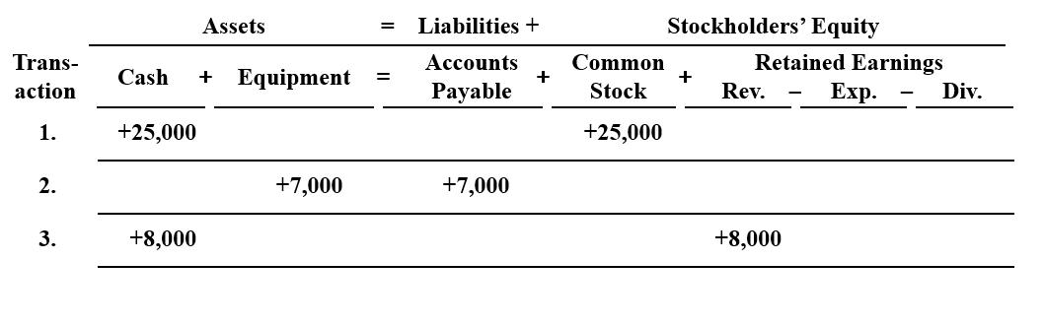
DO IT! 4: Tabular Analysis Cash received for services
The company received $8,000 cash in exchange for services performed.
L O 4

Slide 59
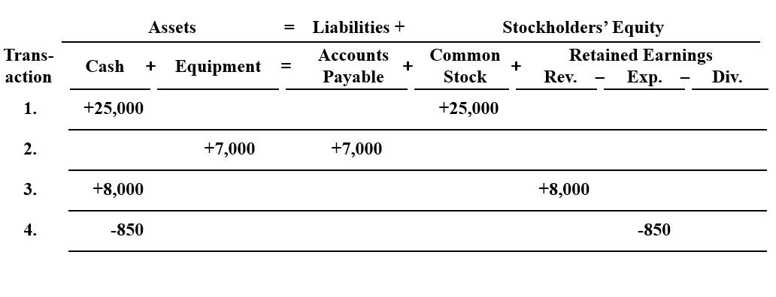
DO IT! 4: Tabular Analysis Rent payment
The company paid $850 for this month’s rent.
L O 4

Slide 60
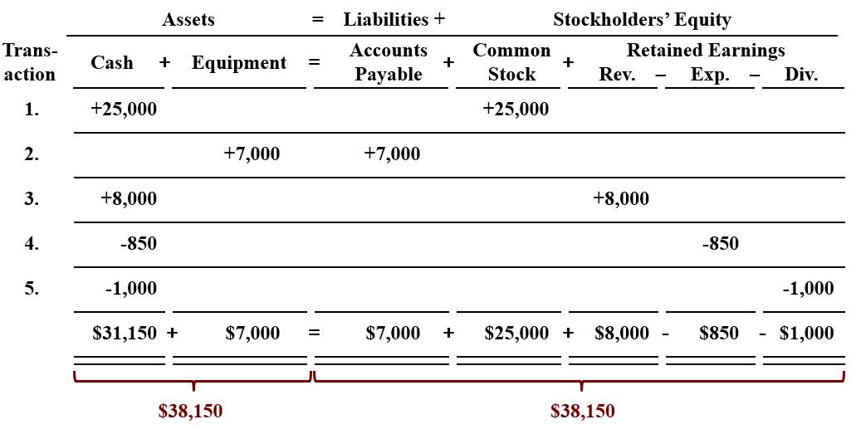
DO IT! 4: Tabular Analysis Payment of dividends
The company paid a dividend of $1,000 in cash to stockholders.
L O 4

Slide 61
LEARNING OBJECTIVE 5 Describe the Four Financial Statements and How they are Prepared
Companies prepare four financial statements:
Income Statement
Retained Earnings Statement
Balance Sheet
Statement of Cash Flows
L O 5

Slide 62
Financial Statements First Question
Net income will result during a time period when:
assets exceed liabilities.
assets exceed revenues.
expenses exceed revenues.
revenues exceed expenses.
L O 5

Slide 63
Financial Statements First Answer
Net income will result during a time period when:
assets exceed liabilities.
assets exceed revenues.
expenses exceed revenues.
Answer: revenues exceed expenses.
L O 5

Slide 64
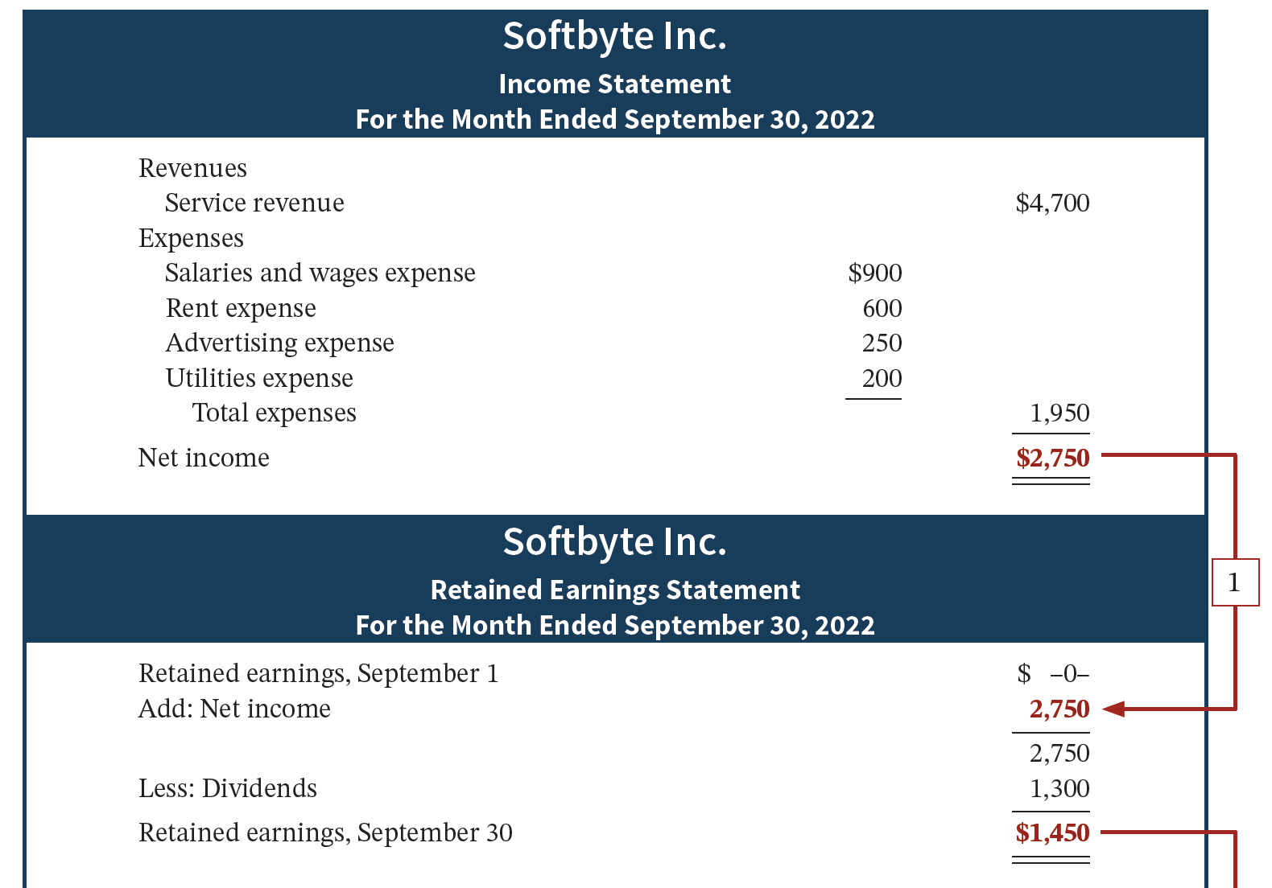
Financial Statements Income Statement and Retained Earnings Statement
Net income is needed to determine the ending balance in retained earnings.
L O 5

Slide 65
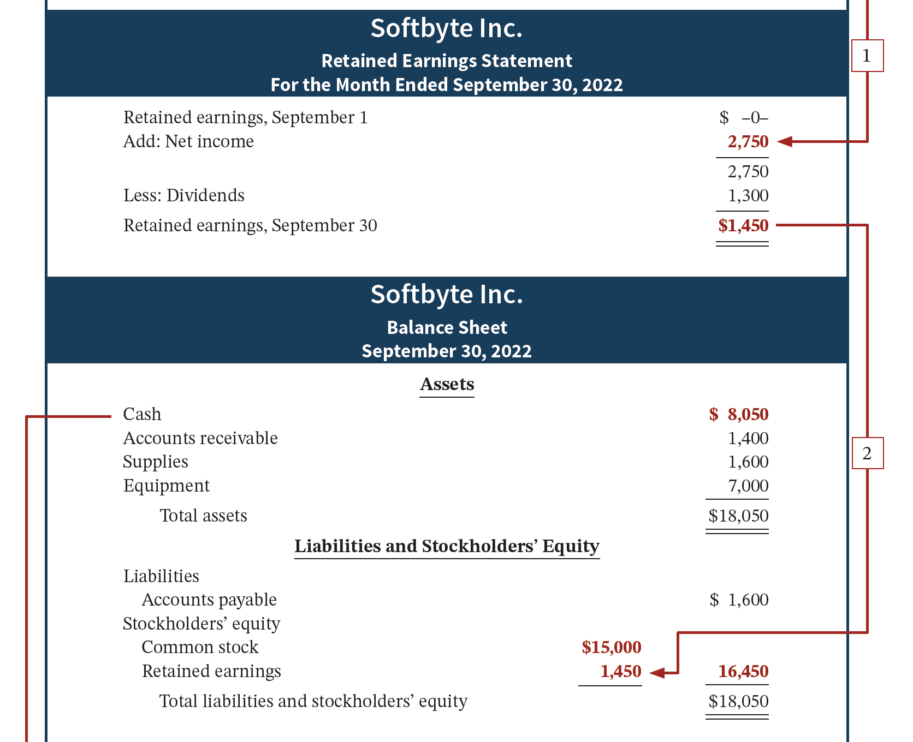
Financial Statements Retained Earnings Statement and Balance Sheet
Ending balance in retained earnings is needed in preparing the balance sheet.
L O 5

Slide 66
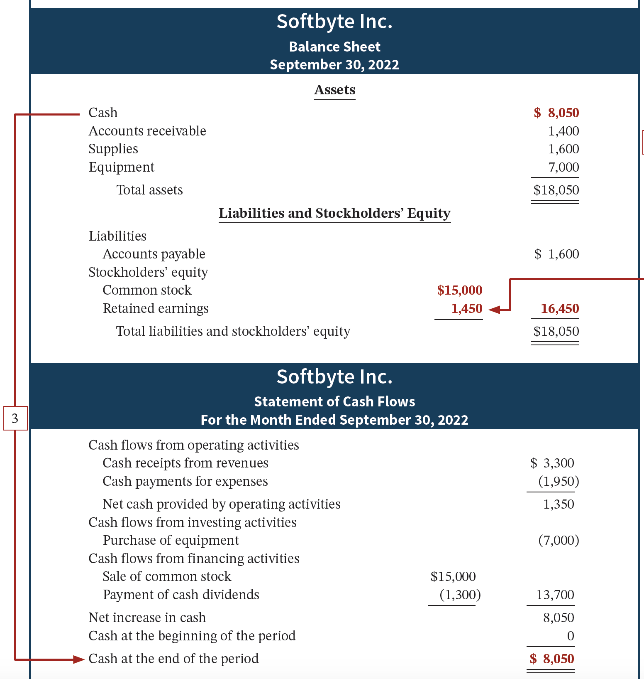
Financial Statements Balance Sheet and Statement of Cash Flows
Balance sheet and income statement are needed to prepare the statement of cash flows.
L O 5

Slide 67
Income Statement
Reports the profitability of the company’s operations over a specific period of time.
Lists revenues first, followed by expenses.
Shows net income (or net loss).
Does not include investment and dividend transactions between the stockholders and the business.
Alternative Terminology
The income statement is sometimes referred to as the statement of operations, earnings statement, or profit and loss statement.
L O 5

Slide 68
Retained Earnings Statement
Reports the changes in retained earnings for a specific period of time.
The time period is the same as that covered by the income statement.
Information provided by this statement indicates the reasons why retained earnings increased or decreased during the period.
L O 5

Slide 69
Balance Sheet
Reports the assets, liabilities, and stockholders’ equity at a specific date.
Lists assets at the top, followed by liabilities and stockholders’ equity.
Total assets must equal total liabilities and stockholders’ equity.
Is a snapshot of the company’s financial condition at a specific moment in time (usually the month-end or year-end).
L O 5

Slide 70
Statement of Cash Flows
Provides financial information about the cash receipts and payments for a specific period of time.
Answers the following:
Where did cash come from?
What was cash used for?
What was the change in the cash balance?
Helpful Hint
The income statement, retained earnings statement, and statement of cash flows are all for a period of time, whereas the balance sheet is for a point in time.
L O 5

Slide 71
Financial Statements Second Question
Which of the following financial statements is prepared as of a specific date?
Balance sheet.
Income statement.
Retained earnings statement.
Statement of cash flows.
L O 5

Slide 72
Financial Statements Second Answer
Which of the following financial statements is prepared as of a specific date?
Answer: Balance sheet.
Income statement.
Retained earnings statement.
Statement of cash flows.
L O 5

Slide 73

People, Planet, and Profit Insight
Beyond Financial Statements
Should we expand our financial statements beyond the income statement, retained earnings statement, balance sheet, and statement of cash flows? Some believe we should take into account ecological and social performance, in addition to financial results, in evaluating a company. The argument is that a company’s responsibility lies with anyone who is influenced by its actions. In other words, a company should be interested in benefiting many different parties, instead of only maximizing stockholders’ interests.
A socially responsible business does not exploit or endanger any group of individuals. It follows fair trade practices, provides safe environments for workers, and bears responsibility for environmental damage. Granted, measurement of these factors is difficult. How to report this information is also controversial. But, many interesting and useful efforts are underway. Throughout this text, we provide additional insights into how companies are attempting to meet the challenge of measuring and reporting their contributions to society, as well as their financial results, to stockholders.
L O 5

Slide 74
People, Planet, and Profit Insight (Question and Answer)
Beyond Financial Statements
Why might a company’s stockholders be interested in its environmental and social performance?
Answer:
Many companies now recognize that being a socially responsible organization is not only the right thing to do, but it also is good for business. Many investment professionals understand, for example, that environmental, social, and proper corporate governance of companies affects the performance of their investment portfolios. For example, British Petroleum's oil spill disaster is a classic example of the problems that can occur for a company and its stockholders. British Petroleum's stock price was slashed, its dividend reduced, its executives replaced, and its reputation badly damaged. It is interesting that socially responsible investment funds are now gaining momentum in the marketplace such that companies now recognize this segment as an important investment group.
L O 5

Slide 75
DO IT! 5: Financial Statement Items Information needed
Presented below is selected information related to Flanagan Corporation at December 31, 2022. Flanagan reports financial information monthly.
Equipment | $ 10,000
Cash | 8,000
Service Revenue | 36,000
Rent Expense | 11,000
Accounts Payable | 2,000
Utilities Expense | $ 4,000
Accounts Receivable | 9,000
Salaries and Wages Expense | 7,000
Notes Payable | 16,500
Dividends | 5,000
Determine the total assets of Flanagan at December 31, 2022.
Determine the net income that Flanagan reported for December 2022.
Determine the stockholders’ equity of Flanagan at December 31, 2022.
L O 5

Slide 76
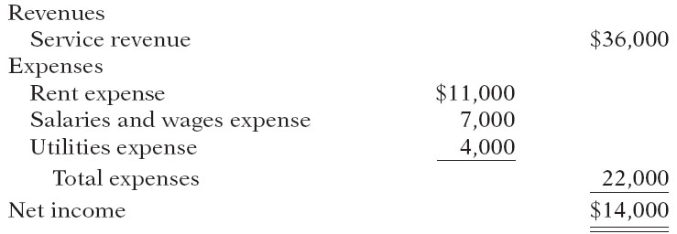
DO IT! 5: Financial Statement Items Total Assets and Net Income
Solution
The total assets are $27,000, comprised of Cash $8,000, Accounts Receivable $9,000, and Equipment $10,000.
Net income is $14,000, computed as follows.
L O 5

Slide 77
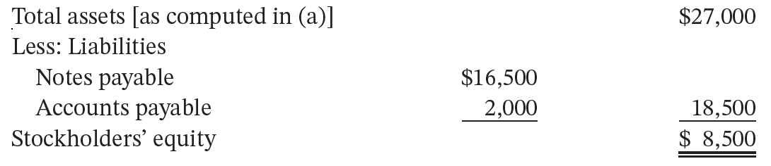
DO IT! 5: Financial Statement Items Ending Stockholders’ Equity
The ending stockholders’ equity of Flanagan Corporation is $8,500. By rewriting the accounting equation, we can compute stockholders’ equity as assets minus liabilities, as follows.
Note that it is not possible to determine the corporation’s stockholders’ equity in any other way, because the beginning total for stockholders’ equity is not provided.
L O 5

Slide 78
LEARNING OBJECTIVE 6 APPENDIX 1A: Explain the Career Opportunities in Accounting
Public Accounting
Careers in auditing, taxation, and management consulting serving the general public.
Private Accounting
Careers in industry working in cost accounting, budgeting, accounting information systems, and taxation.
Governmental Accounting
Careers with the I R S, the F B I, the S00E C, public colleges and universities, and in state and local governments.
Forensic Accounting
Uses accounting, auditing, and investigative skills to conduct investigations into theft and fraud.
L O 6

Slide 79
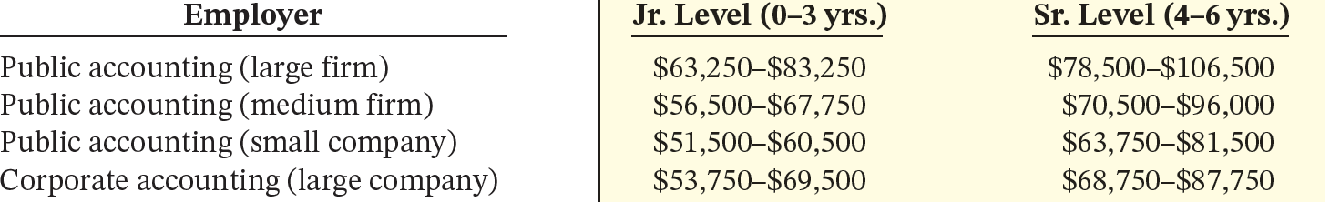
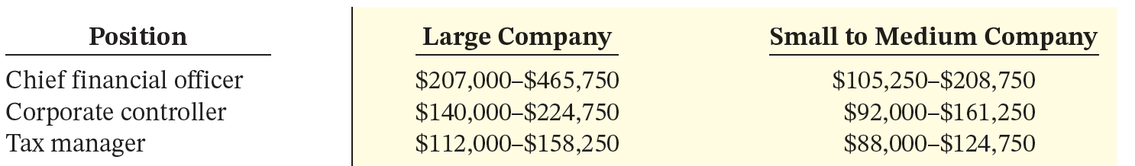
“Show Me the Money”
Salary estimates for jobs in public and corporate accounting
Upper-level management salaries in corporate accounting
L O 6

Slide 80
A Look at I F R S Similarities
L O 7: Describe the Impact of International Accounting Standards on U.S. Financial Reporting
Key Points
Similarities
The basic techniques for recording business transactions are the same for U.S. and international companies.
Both international and U.S. accounting standards emphasize transparency in financial reporting. Both sets of standards are primarily driven by meeting the needs of investors and creditors.
The three most common forms of business organizations, proprietorships, partnerships, and corporations, are also found in countries that use international accounting standards.
L O 7

Slide 81
A Look at IFRS Differences
Key Points
Differences
International standards are referred to as International Financial Reporting Standards (I F R S), developed by the International Accounting Standards Board. Accounting standards in the United States are referred to as generally accepted accounting principles (G A A P) and are developed by the Financial Accounting Standards Board.
I F R S tends to be simpler in its accounting and disclosure requirements; some people say it is more “principles-based.” G A A P is more detailed; some people say it is more “rules-based.”
L O 7

Slide 82
A Look at I F R S More Differences
Key Points
More Differences
The internal control standards applicable to Sarbanes-Oxley (S O X) apply only to large public companies listed on U.S. exchanges. There is continuing debate as to whether non-U.S. companies should have to comply with this extra layer of regulation.
L O 7

Slide 83
A Look at I F R S Benefits Question
I F R S Self-Test Questions
Which of the following is not a reason why a single set of high-quality international accounting standards would be beneficial?
Mergers and acquisition activity.
Financial markets.
Multinational corporations.
G A A P is widely considered to be a superior reporting system.
L O 7

Slide 84
A Look at I F R S Benefits Answer
I F R S Self-Test Questions
Which of the following is not a reason why a single set of high-quality international accounting standards would be beneficial?
Mergers and acquisition activity.
Financial markets.
Multinational corporations.
Answer: G A A P is widely considered to be a superior reporting system.
L O 7

Slide 85
A Look at I F R S SOX Question
I F R S Self-Test Questions
The Sarbanes-Oxley Act determines:
international tax regulations.
internal control standards as enforced by the I A S B.
internal control standards of U.S. publicly traded companies.
U.S. tax regulations.
L O 7

Slide 86
A Look at I F R S SOX Answer
I F R S Self-Test Questions
The Sarbanes-Oxley Act determines:
international tax regulations.
internal control standards as enforced by the I A S B.
Answer: internal control standards of U.S. publicly traded companies.
U.S. tax regulations.
L O 7

Slide 87
A Look at I F R S Comparison Question
I F R S Self-Test Questions
I F R S is considered to be more:
principles-based and less rules-based than G A A P.
rules-based and less principles-based than G A A P.
detailed than G A A P.
None of the answer choices is correct.
L O 7

Slide 88
A Look at I F R S Comparison Answer
I F R S Self-Test Questions
I F R S is considered to be more:
Answer: principles-based and less rules-based than G A A P.
rules-based and less principles-based than G A A P.
detailed than G A A P.
None of the answer choices is correct.
L O 7

Slide 89
Copyright
©2020 John Wiley & Sons, Inc. All rights reserved.
No part of this publication may be reproduced, stored in a retrieval system, or transmitted, in any form or by any means, electronic, mechanical, photocopying, recording or otherwise, except as permitted by law. Advice on how to obtain permission to reuse this material is available at http://www.wiley.com/go/permissions.

